Slide 1
EIT x Soft Robots: project update
Week of Monday 09/08/2021

Slide 2
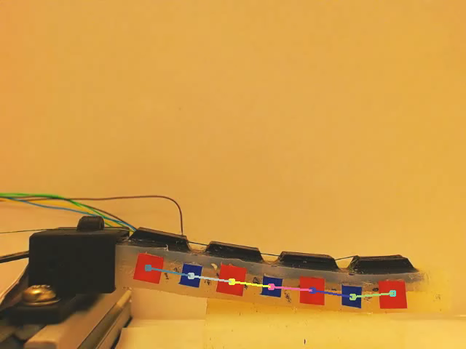
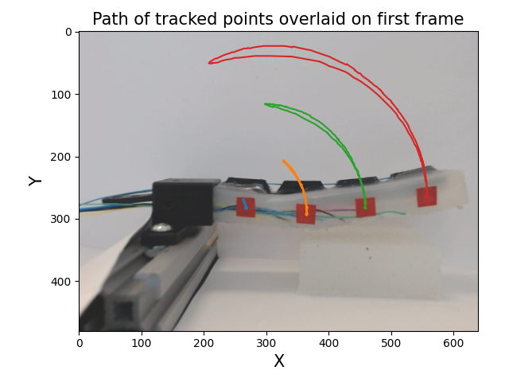
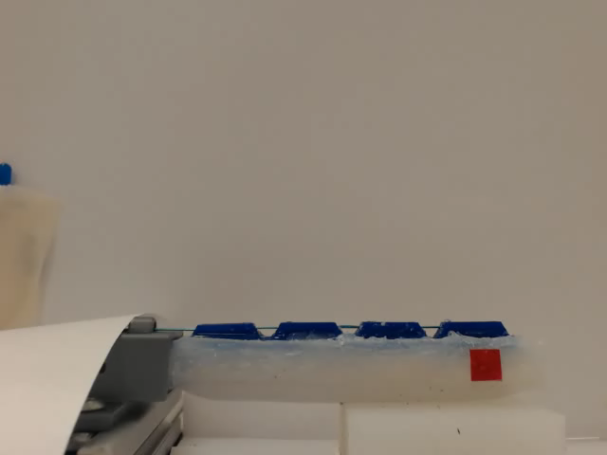
Computer vision progress

Slide 3
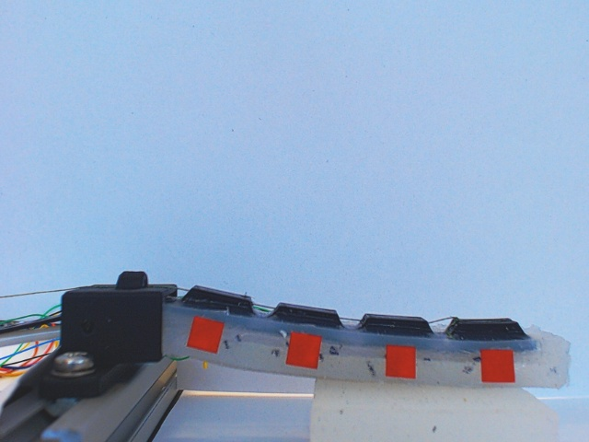
Copper wire actuator data

Slide 4
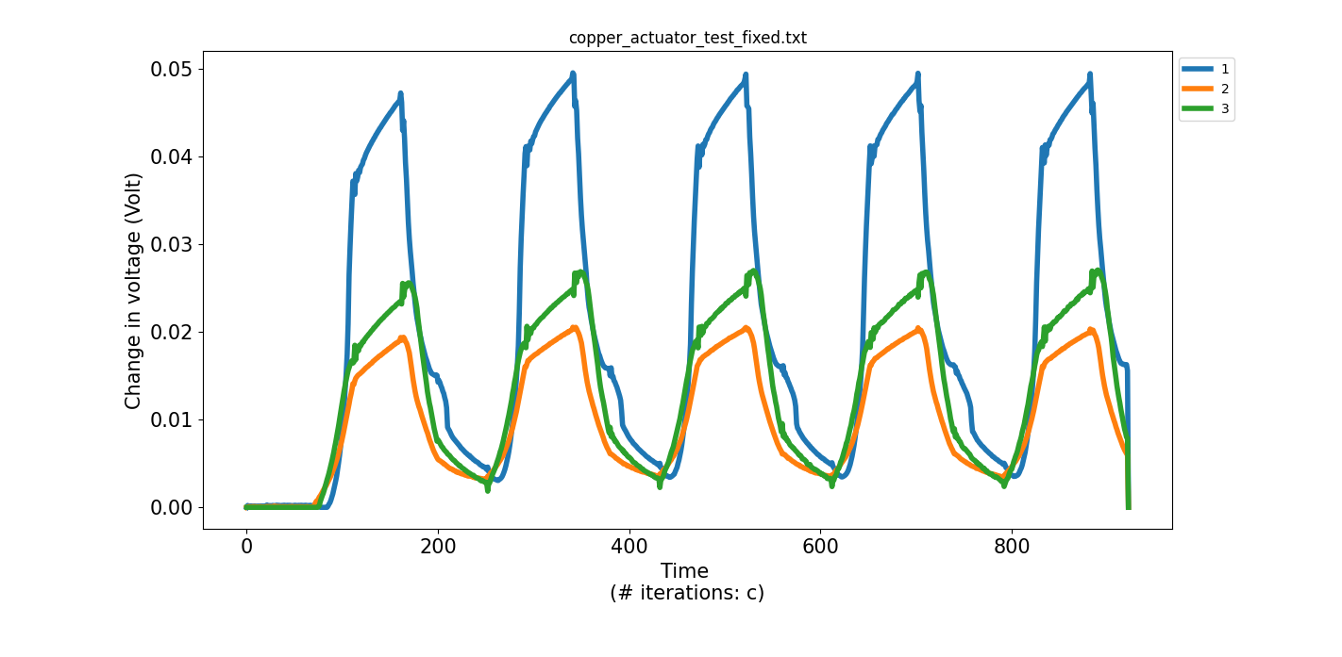
Copper wire actuator data

